Slide 1

Master‘s Thesis Product Categorisation for Customer Recommendation
Abhishek Ravindra Kurup
Project Management and Data Science (MPMD)
1st Supervisor - Prof. Dr. Tilo Wendler
2nd Supervisor - Dr. Yousof Mardoukhi

Slide 2
Agenda
Introduction
Company history
Business use-case
Background study
Approach
Results and Conclusion
Q&A

Slide 3
Introduction
Company background
Started as JuwelKerze Gmbh in 2013, now renamed as GG Brands Gmbh.
Producer of luxury scented candles with surprise jewellery inside.
Sold online via company website and online marketplaces like Amazon, eBay, and offline with the help of B2B partners.
Products sold in European markets, the U.S and India.

Slide 4
Business use-case
Current version of website includes a recommender engine developed by the Shopify platform which provides static and non-personalised recommendations.
Major goal is to develop a recommendation system that utilises the colours and smell of the products to provide recommended products that are “similar” to customer selection.
Goal of this thesis is to focus only on the colours of the products.
Try different approaches to group products with similar colours and finalise on the best approach.

Slide 5
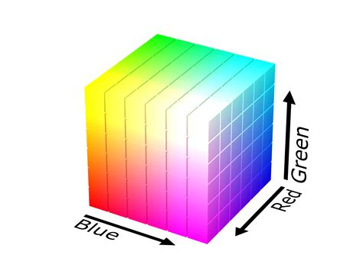
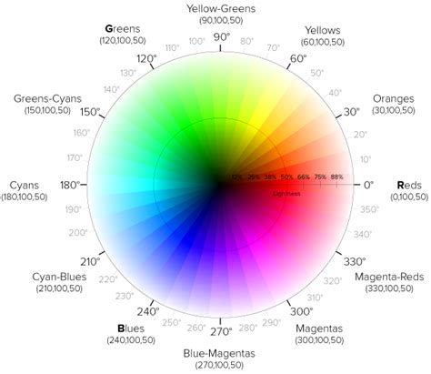
Background Study
Colours and Colour Models
Primary attributes are Hue, Saturation and Lightness.
Colour models primarily researched include, RGB, HSL, Munsell, CIE and Pantone.
The HSL model was selected to be the base model to cluster colours due to the continuity of colours in the model and the ease of use computationally when compared to the other colour models.
Pantone codes, although being used to identify the colours of the candles, cannot be used in this analysis due to restriction over free usage.

Slide 6

Approach
Data preparation
The product information stored in the database only includes the “pantone code” to identify the colour along with a generic name of the colour.
These pantone codes needed to be converted to HSL values before the modelling can take place.
This conversion takes place as per the below steps.
A third party source had to be used to obtain the approximate Hex values of the respective Pantone codes.

Slide 7
Different models experimented with
Custom function that programmatically compares the Hue, Saturation and Lightness attribute groups that was manually created between the selected product and the other products in the database.
Mathematical function to calculate the Euclidean distance between the colour attributes of selected product and the other products in the database.
K-means clustering on the entire dataset to generate labels based on the colour attributes for each product.
DBSCAN clustering on the entire dataset to generate labels based on the colour attributes for each product.

Slide 8
Custom function with manual grouping
The Hue, Saturation and Lightness attributes are split into subgroups as per the below logic.
Hue split into groups of 30 degrees each (0-30, 31-60, etc..) for the 360 degrees of the Hue colour wheel.
Saturation and lightness are split into groups of 20 units for the 100% of values.
This function works by first comparing the values of the colour attributes and retrieving a set number of results and if the number of results is less than the set threshold, then the range of search for saturation and lightness are increased. This process continues till the threshold is reached.
This function does not create clusters of products but instead returns a set number of products that are similar to the main product.

Slide 9
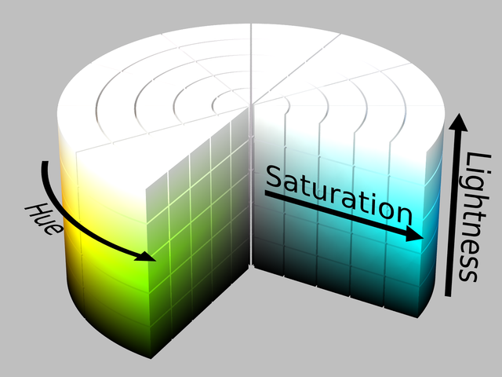
Calculation of Euclidean distance between product attributes.
This mathematical function tries to use the Euclidean distance formula to calculate the distances between two products.
The Euclidean distance formula for 3-coordinates was used to accommodate the Hue, Saturation and Lightness values.
The Hue had to be converted from degrees to radians in order to calculate the difference more efficiently.
Similar to the custom function, this distance calculations function also returns a set number of products that have the least distance with the main product.
Another point in common is the need to run the function on the entire data set each time a “recommendation” is required.

Slide 10
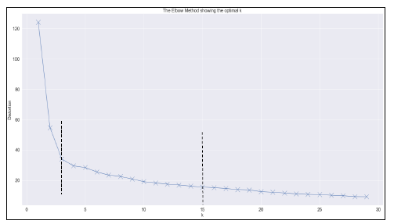
K-Means clustering of products
Using the Hue, Saturation and Lightness attributes to fit a K-Means model and generate clusters for the entire dataset.
The value of K, which is the number of clusters to generate, has to be determined and that was done with the help of the elbow method.
Using the label for the main product to retrieve all the products having the same label as recommendations.

Slide 11
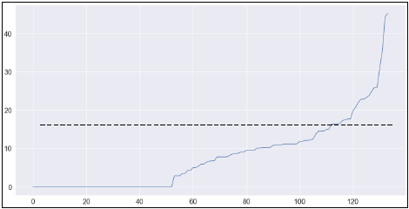
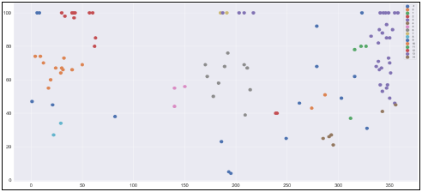
DBSCAN clustering of products
Density-Based Spatial Clustering of Applications with Noise or DBSCAN algorithm is used in cases when the clusters might not necessarily be in a consistent shape.
Similar to K-Means clustering, the Hue, Saturation and Lightness attributes are again used to create clusters with the help of DBSCAN algorithm.
DBSCAN needs an epsilon(Eps) parameter, which is the radius within which the algorithm would search for similarity.
The optimal Eps needs to be determined separately by calculating the distance between the datapoints and plotting them and observing the point at which the change is more pronounced.
An important point to note with DBSCAN is that this algorithm produces noise, i.e. results that don’t fit into any cluster and these are wasted data points.

Slide 12
Results
The algorithms had to be evaluated in two different ways, the more visually similar result and the most optimal.
Visual Results

Slide 13
Initial observations for all algorithms
The below observations were made based on the visual results and the performance of each algorithm
The custom function and Euclidean distance function although produced satisfactory visual results, the need to run the algorithm on the entire dataset every time a “recommendation” would be needed is a disadvantage. This would be an expensive process in terms of processing power and might cause the website to also function poorly.
The two clustering algorithms, K-Means and DBSCAN, do not have this disadvantage as the clustering needs to be done once in a while when ever a new product is added to the database.
Based on these observations, K-Means and DBSCAN seems to be better among the four algorithms tested.

Slide 14
Quantitative results between K-Means and DBSCAN
As the K-Means and DBSCAN algorithms are better in terms of overall performance, the next step is to identify which is the better model among the two.
Davies-Bouldin index score is a quantitative measure to determine the model that performed a better clustering between unsupervised clustering models.
The score is generated by comparing the average similarity between clusters generated by a model. The model having the lower score is considered to be a better model.
By comparing the scores generated for K-Means and DBSCAN, it was determined that the K-means model performed better.

Slide 15
Summary and Conclusion
This thesis focused on the exploration of an optimal method to cluster colours which is a part of the bigger project which also includes clustering smells.
This concept is being developed to provide better product recommendations which would be similar to products that a customer might choose on the product website.
Starting with understanding colours and the different colour models to work with, the process of clustering colours of the products involved exploring different algorithms and custom functions.
After comparing the visual and quantitative results along with general observations made during the experimentation, it was inferred that the K-Means model worked best for our use-case.
Some of the disadvantages the other algorithms had over K-Means include, low efficiency, high cost and wastage of data due to noise.

Slide 16
Future scope and development
Concluding the exploration of an optimal model to cluster products based on its colour attributes, the next goal would be to find an optimal method to cluster products based on its smells.
This is slightly complicated as it would involve a deeper understanding of customer preferences of smell as well as mapping these preferences to the structure of a fragrance.
Fragrances are usually designed with three layers, namely, the head, heart and base. Some fragrances might only contain a single layer, but with multiple layers it is important to understand the preferences of customers as well.

Slide 17
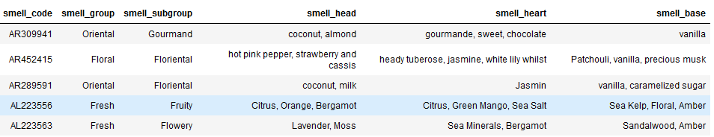
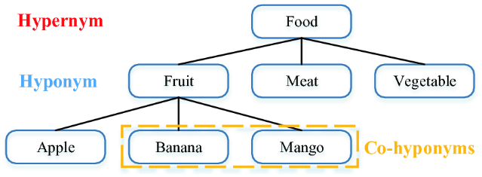
A sample of the available fragrance attributes for the products sold by GGB is as below.
Although the smell group and subgroup could potentially be used as labels for each smell, there are chances that the smell tones might not really match due to inconsistent naming conventions. The differences can also be observed with the help of the ingredients or the smell profiles in the “smell_head”, “smell_heart” and “smell_base” fields.
To tackle this problem, a potential approach would be to utilise the concept of hypernyms and hyponyms in natural language processing.
By identifying the families of the smells, it would be possible to further create clusters with the help of clustering algorithms such as K-Means.
Finally, once the clusterings are available, the products that fit in both, the colour cluster and the smell cluster could be “recommended” to a customer.

Slide 18
Q&A

Slide 19
Thank You

